Slide 1
Project 1: Sleep Study
Lydia Bartnick
Anna Collawn
Gil Fernandez
Jared Sletto

Slide 2
Overview
Exploring the different relationships within the dataset.
Is there a relationship between sleep duration, quality of sleep, and physical activity with different physiological responses?
Does age, gender, and profession play a role in the duration and quality of sleep?

Slide 3
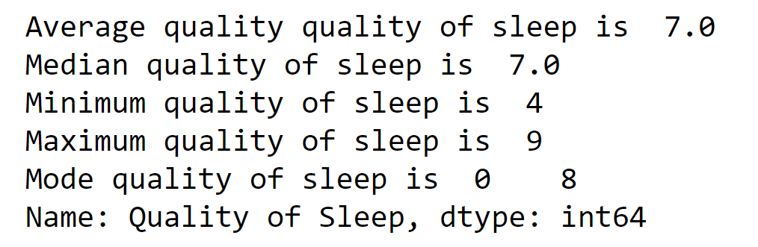
Quality of Sleep
Quality of sleep is the measurement of how well someone sleeps at night. The average adult needs 7 or more hours of restful and restorative sleep.

Slide 4
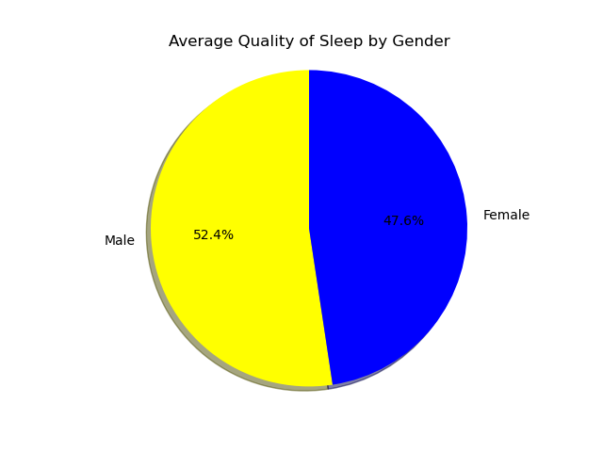
Which Gender Gets the Better Quality of Sleep?
In this dataset, 185 males and 189 females were analyzed. On average, the men from the dataset get a more restful and restorative sleep. Men, on average, received 8 hours of quality sleep, while women received 7 hours.

Slide 5
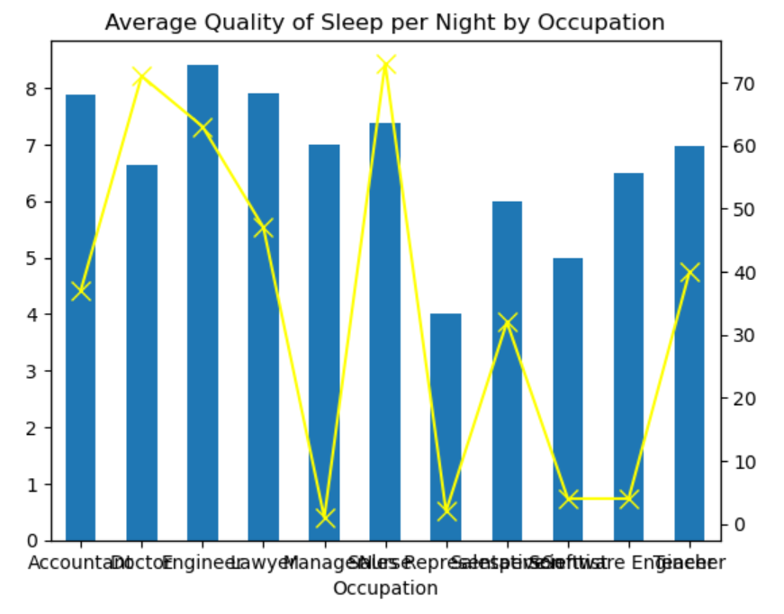
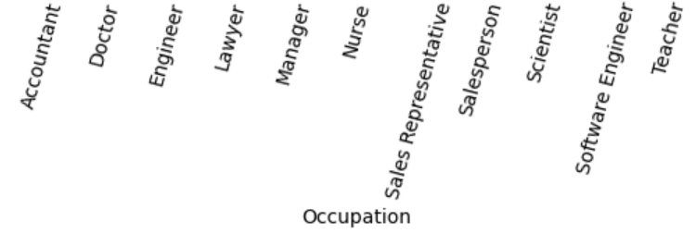
Which Profession Gets Better Quality of Sleep?
Eleven professions were analyzed from different industries. This graph represents the average quality of sleep per occupation compare to the total count of each occupation.
The uneven count of each profession proves to be a limitation to our data. For example, Manager occupation only has only 1 count and an average quality of sleep, where as doctor has a 71 count and a below average quality of sleep.
Notes:
The left y-axis represents the average quality of sleep per profession, while the right y-axis represents the total count per profession.

